Slide 1

UNIVERSITY INSTITUTE OF ENGINEERING
DEPARTMENT OF COMPUTER SCIENCE AND ENGG.
Bachelor of Engineering (Computer Science & Engineering)
DATA STRUCTURES
TREES
DISCOVER . LEARN . EMPOWER

Slide 2
Threaded Binary Tree
In the linked representation of binary trees, more than one half of the link fields contain NULL values which results in wastage of storage space. If a binary tree consists of n nodes then n+1 link fields contain NULL values.
So in order to effectively manage the space, a method was devised by Perlis and Thornton in which the NULL links are replaced with special links known as threads.
Such binary trees with threads are known as threaded binary trees. Each node in a threaded binary tree either contains a link to its child node or thread to other nodes in the tree.

Slide 3
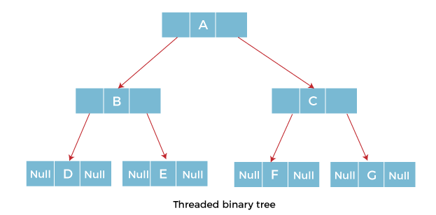

Slide 4
Types of Threaded Binary Tree
One-way threaded Binary Tree
Two-way threaded Binary Tree

Slide 5
One-way threaded Binary trees
In one-way threaded binary trees, a thread will appear either in the right or left link field of a node.
If it appears in the right link field of a node then it will point to the next node that will appear on performing in order traversal. Such trees are called Right threaded binary trees.
If thread appears in the left field of a node then it will point to the nodes in order predecessor. Such trees are called Left threaded binary trees.
Left threaded binary trees are used less often as they don't yield the last advantages of right threaded binary trees. In one-way threaded binary trees, the right link field of last node and left link field of first node contains a NULL. In order to distinguish threads from normal links they are represented by dotted lines.

Slide 6
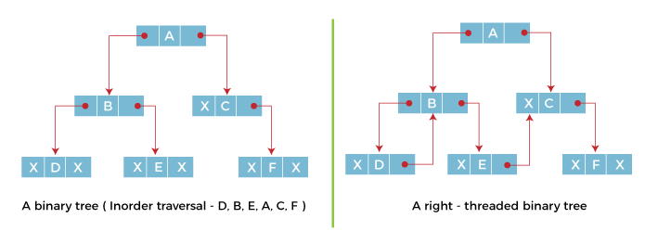
The above figure shows the inorder traversal of this binary tree yields D, B, E, A, C, F. When this tree is represented as a right threaded binary tree, the right link field of leaf node D which contains a NULL value is replaced with a thread that points to node B which is the inorder successor of a node D. In the same way other nodes containing values in the right link field will contain NULL value.

Slide 7
Two-way threaded Binary Trees
In two-way threaded Binary trees, the right link field of a node containing NULL values is replaced by a thread that points to nodes inorder successor and left field of a node containing NULL values is replaced by a thread that points to nodes inorder predecessor.

Slide 8
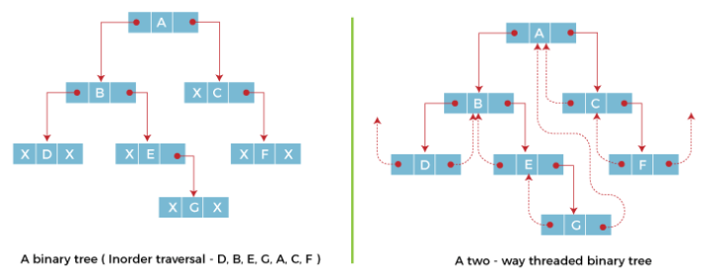
The above figure shows the inorder traversal of this binary tree yields D, B, E, G, A, C, F. If we consider the two-way threaded Binary tree, the node E whose left field contains NULL is replaced by a thread pointing to its inorder predecessor i.e. node B. Similarly, for node G whose right and left linked fields contain NULL values are replaced by threads such that right link field points to its inorder successor and left link field points to its inorder predecessor. In the same way, other nodes containing NULL values in their link fields are filled with threads.

Slide 9
Binary Search Trees (BST)
A data structure for efficient searching, insertion and deletion
Binary search tree property
For every node X
All the keys in its left subtree are smaller than the key value in X
All the keys in its right subtree are larger than the key value in X

Slide 10
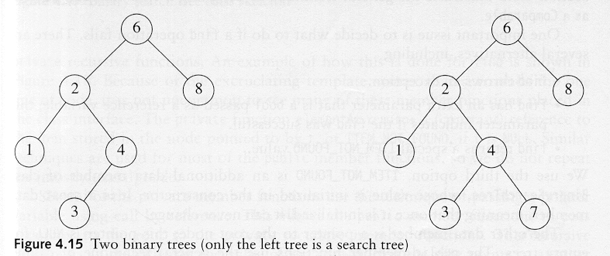
Binary Search Trees
A binary search tree
Not a binary search tree

Slide 11
Binary Search Trees
The same set of keys may have different BSTs
Average depth of a node is O(log N)
Maximum depth of a node is O(N)

Slide 12
Algorithm for searching in a BST
FIND(INFO,LEFT,RIGHT,ROOT,ITEM,LOC,PAR) : A binary search tree T is in memory and an ITEM of information is given. This procedure finds the location LOC of ITEM in T and also location PAR of the parent of ITEM. There are 3 special cases:
(i) LOC=NULL and PAR=NULL will indicate that the tree is empty..
(ii) LOC≠NULL and PAR=NULL will indicate that the ITEM is the root of T.
(iii) LOC=NULL and PAR≠NULL will indicate that ITEM is not in T and can be added to T as a child of the node N with location PAR.
[Tree empty?]
If ROOT=NULL, then, Set LOC=NULL and PAR=NULL and return.
[ITEM at root?]
If ITEM=INFO[ROOT], then: Set LOC=ROOT and PAR=NULL and return.
[Initialize pointers PTR and SAVE]
If ITEM<INFO[ROOT], then:
Set PTR=LEFT[ROOT] and SAVE=ROOT
Else
Set PTR=RIGHT[ROOT] and SAVE=ROOT
[End of If structure]
Repeat steps 5 to 6 while PTR≠NULL:
[ITEM found?]
If ITEM=INFO[PTR], then: Set LOC=PTR and PAR=SAVE and return.
If ITEM<INFO[PTR], then:
Set SAVE=PTR and PTR=LEFT[PTR]
Else
Set SAVE=PTR and PTR=RIGHT[PTR]
[End of If structure]
[End of step4 loop]
7. [Search unsuccessful] Set LOC=NULL and PAR=SAVE
8. Exit

Slide 13
Searching BST
If we are searching for 15, then we are done.
If we are searching for a key < 15, then we should search in the left subtree.
If we are searching for a key > 15, then we should search in the right subtree.

Slide 15
Inorder Traversal of BST
Inorder traversal of BST prints out all the keys in sorted order
Inorder: 2, 3, 4, 6, 7, 9, 13, 15, 17, 18, 20

Slide 16
findMin/ findMax
Goal: return the node containing the smallest (largest) key in the tree
Algorithm: Start at the root and go left (right) as long as there is a left (right) child. The stopping point is the smallest (largest) element
Time complexity = O(height of the tree)
BinaryNode * BinarySearchTree::FindMin(BinaryNode *t) const
{
if (t == NULL)
return NULL;
if (t->left == NULL)
return t;
return FindMin(t->left);
}

Slide 17
Algorithm for inserting in a BST
INSBST(INFO,LEFT,RIGHT,ROOT,AVAIL,ITEM,LOC) : A binary search tree T is in memory and an ITEM of information is given. This procedure finds the location LOC of ITEM in T or adds ITEM as a new node in T at location LOC.
1. Call FIND(INFO,LEFT,RIGHT,ROOT,ITEM,LOC,PAR)
2. If LOC≠NULL, then: Exit.
3. [Copy ITEM into new node in AVAIL list.]
(a)If AVAIL=NULL, then: Write: OVERFLOW & Exit.
(b)Set NEW=AVAIL, AVAIL=LEFT [AVAIL] & INFO [NEW] =ITEM.
(c)Set LOC=NEW, LEFT[NEW]=NULL & RIGHT[NEW]=NULL
4. [Add ITEM to tree]
If PAR=NULL, then:
Set ROOT=NEW [Make it root]
Else if ITEM<INFO [PAR], Then:
Set LEFT [PAR] =NEW
Else
Set RIGHT [PAR] =NEW
[End of if structure]
5. Exit

Slide 18
Insertion
Proceed down the tree as you would with a find
If X is found, do nothing (or update something)
Otherwise, insert X at the last spot on the path traversed
Time complexity = O(height of the tree)

Slide 19
Deletion
When we delete a node, we need to consider how we take care of the children of the deleted node.
This has to be done such that the property of the search tree is maintained.

Slide 20
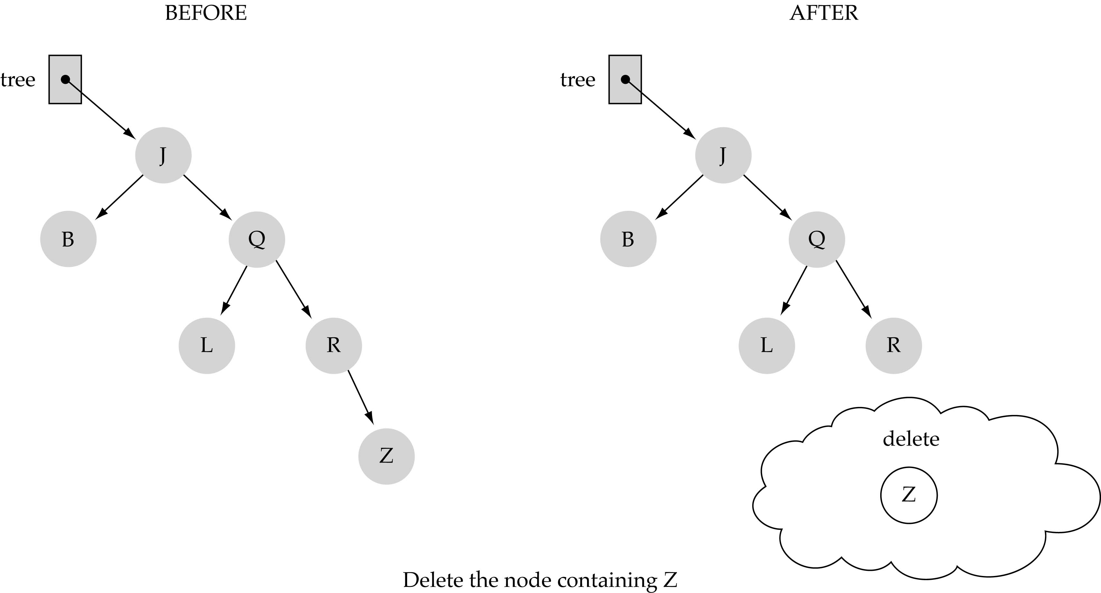
(1) Deleting a leaf

Slide 21
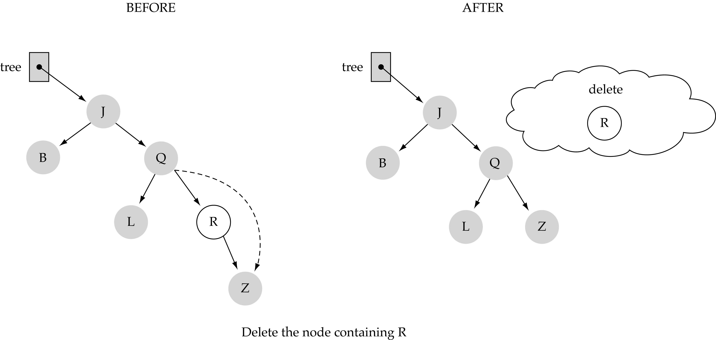
(2) Deleting a node with only one child

Slide 22
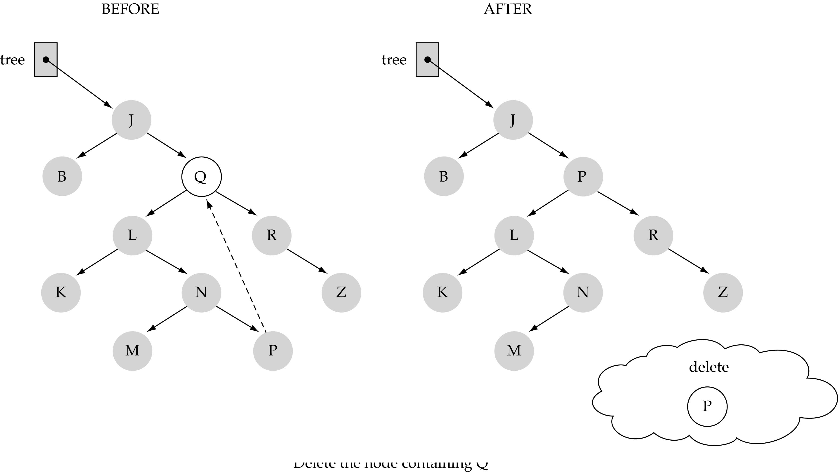
(3) Deleting a node with two children

Slide 23
(3) Deleting a node with two children (cont.)
Find predecessor (i.e., rightmost node in the left subtree)
Replace the data of the node to be deleted with predecessor's data
Delete predecessor node

Slide 24
Deleting in a Binary Search Tree
Algorithm:
If ROOT = NULL, then: Underflow and exit
If ROOT≠NULL , check:
If node to be deleted is a leaf node, then:
Directly delete leaf node.
else if node to be deleted has no left subtree, then:
Right child will take place of the parent node deleted.
else if node to be deleted has no right subtree, then:
left child will take place of the parent node deleted.
else if node to be deleted has left and right subtrees, then:
either of the 2 methods can be implemented:
(a) Find highest valued element among the descendants of left child & replace it with deleted node.
(b) Find lowest valued element among the descendants of right child and replace it with deleted node.
3. Exit

Slide 25
References
Li`pschutz, Seymour, “Data Structures”, Schaum's Outline Series, Tata McGraw Hill.
Data structure and algorithm by Narasimha Karumanchi.
www.tutorialspoint.com
www.geeksforgeeks.com
25

Slide 26
Books Recommended
Goodrich, Michael T., Tamassia, Roberto, and Mount, David M., “Data Structures and Algorithms in C++”, Wiley Student Edition.
Aho, Alfred V., Ullman, Jeffrey D., Hopcroft ,John E. “Data Structures and Algorithms”, Addison Wesley
Lipschutz, Seymour, “Data Structures”, Schaum's Outline Series, Tata McGraw Hill.
Gilberg/Forouzan,” Data Structure with C ,Cengage Learning.
Augenstein,Moshe J , Tanenbaum, Aaron M, “Data Structures using C and C++”, Prentice Hall of India

Slide 27
THANK YOU

